Slide 1
A Project On Tableau Dashboard
Submitted by
Pradip pimpare

Slide 2
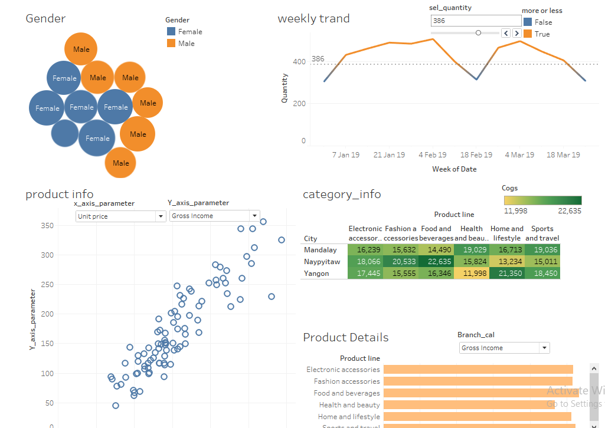
Dashboard on sales of stoore

Slide 3
OBJECTIVES
Product Details
Category Information
Gender wise COGS(cost and good sale)
Details on Various parameters
Weekly trends
Branch Analysis
Video link

Slide 4
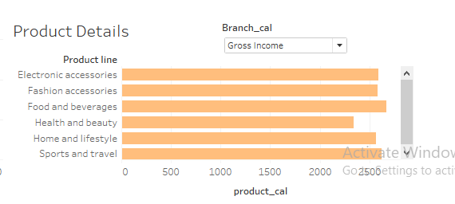
Products details on varous parameter
This graph will give details of various product type such gross income ,cogs and qyantity wise product sale.

Slide 5
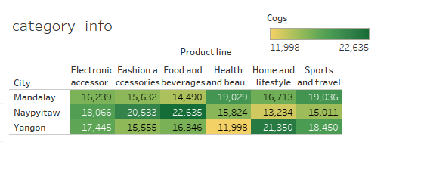
Category wise product sale in city
It shows cost and goods sale in citys. Maximum cogs is 22635 in Naypyitaw by the food and beverages

Slide 6
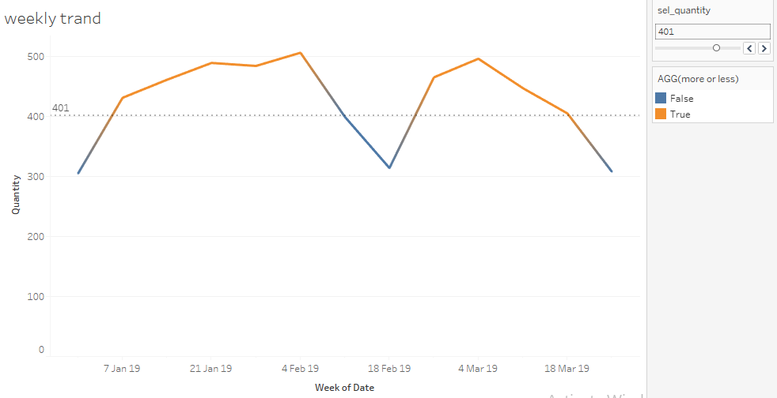
Weekly treand of sales
It showes line in two colours that is if weekly sale is above the average sale then it becomes ‘orangs ’ or else blue. It become easy to analyse.

Slide 7
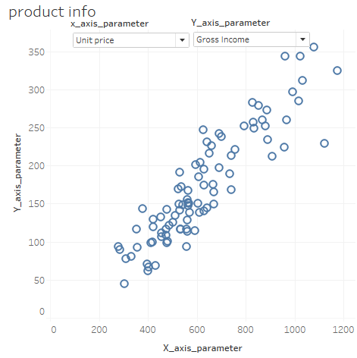
Details on various parameters
In this sheet we are analysing gross income unit price , quantity sale ,cogs income as per the quantity sale .

Slide 8
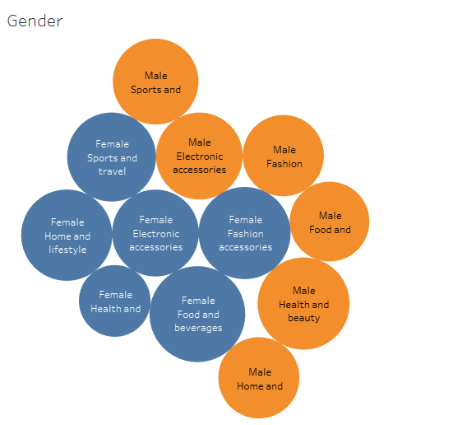
Gender wise COGS
This sheet help us to analayse the traind of male and female in various products type so we can add that type product in stoore.
https://drive.google.com/open?id=1v1QBiL6ODSt2TuxzRp22NqrDcspyiblp

